Slide 1
Welcome to my Presentation on
INDUSTRIAL ATTACHMENT
Course code: CSE311
Presented By
Trained By
Md Sharifuzzaman Shajib
ID: 18CSE032
Session: 2018-2019
Dept. of CSE, BSMRSTU
Md. Marajul Islam
Associate Software Engineer, &
Md Mashiur Al Hasan
Junior Software Engineer,
Brain Station 23
Computer Science and Engineering

Slide 2

Company Profile
Company Name : Brain Station 23
Year of Establishment : 2006
About Company
CEO of Brain Station 23 Raisul Kabir. From 2006 to 2021, the company has not only grown significantly but also has evolved to become the leading Software Development & IT Service Provider company in Bangladesh.
Address:
(Building-1) 8th Floor, 2 Bir Uttam AK Khandakar Road, Mohakhali C/A, Dhaka 1212, Bangladesh
(Building-2) 4th Floor, 4 Bir Uttam AK Khandakar Road, Mohakhali C/A, Dhaka 1212, Bangladesh
Website: https://brainstation-23.com/
Computer Science and Engineering

Slide 3
Introduction
Product of Brain Station 23
Branch of Brain Station 23 (Germany, Norway, Qatar, Canada, USA)
Process of getting work
Client to client
Marketing
Technology work of the company
Shaw Brain Station long portfolio
Long portfolio link : https://brainstationo365-my.sharepoint.com/:p:/g/personal/marajul_islam_brainstation-23_com/EUpmC3IBggZMuPb7oDrGHBoBY_g1I1at0R4qBqN0mVkwdg?rtime=u2XLSHdN2kg
Computer Science and Engineering

Slide 4
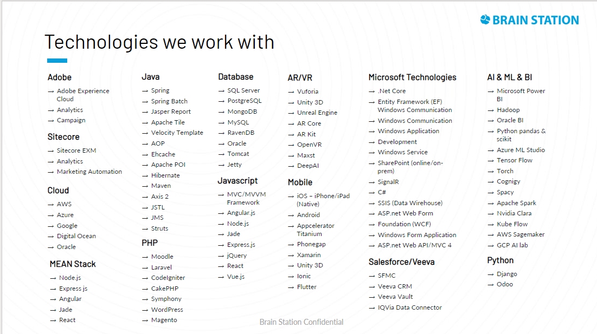
Aspect of Technoogies
Computer Science and Engineering

Slide 5
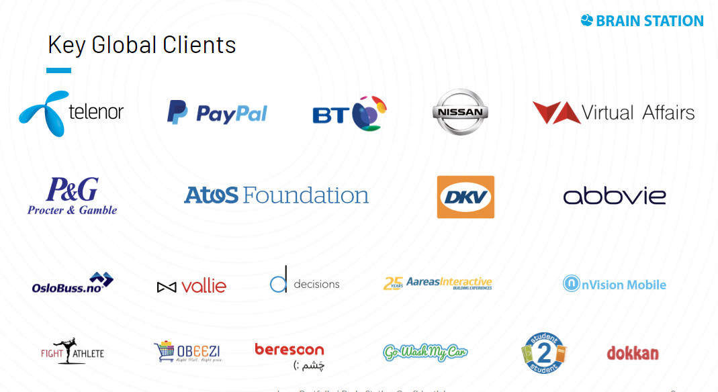
Global Clients
Introduction to Brain Station 23
Computer Science and Engineering

Slide 6
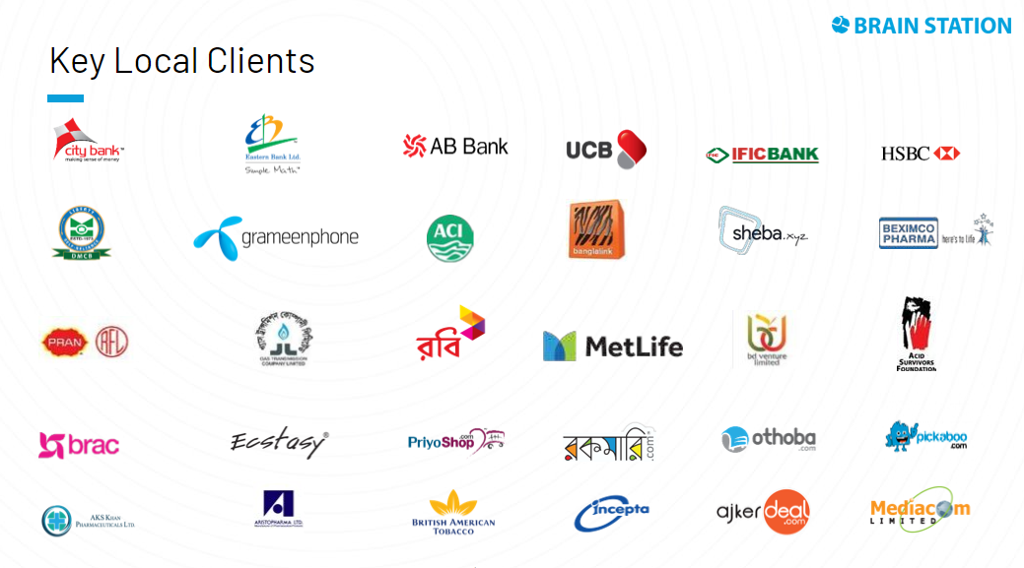
Global Clients
Introduction to Brain Station 23
Computer Science and Engineering

Slide 7
Working Procedure
Discuss about work model
How work start
Regular work report
Computer Science and Engineering

Slide 8
Day 02
Platform of project
Recognition of project
Team create for work
Team member
Project manager
UI designer
Developer
System analyst
Architect
SQA engineer
Business analyst
Responsibility of leading engineer
Computer Science and Engineering

Slide 9
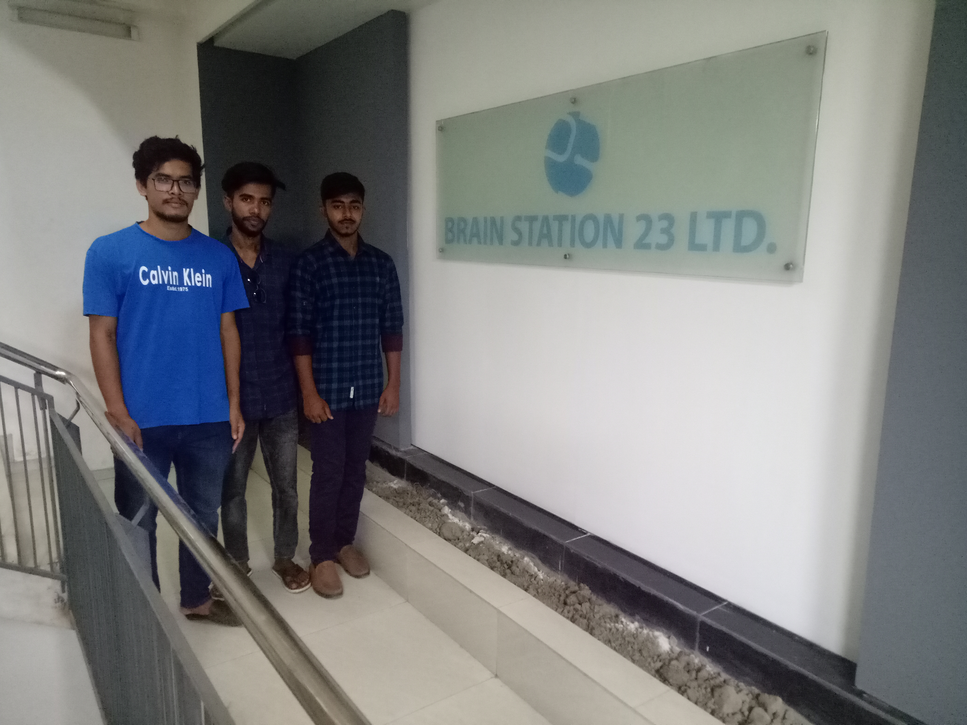
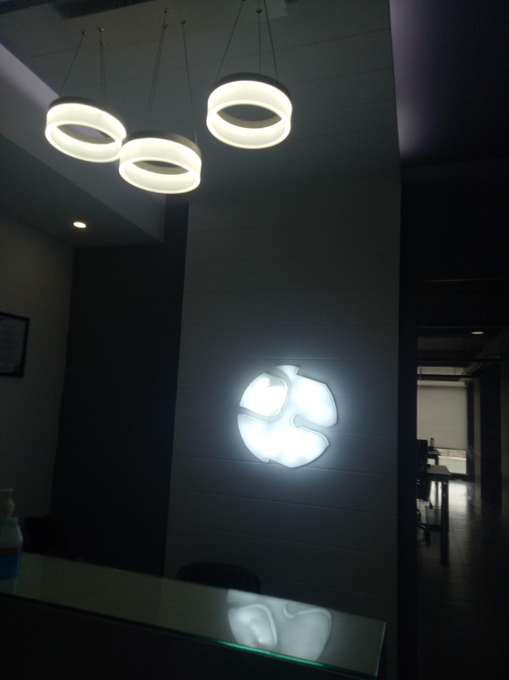
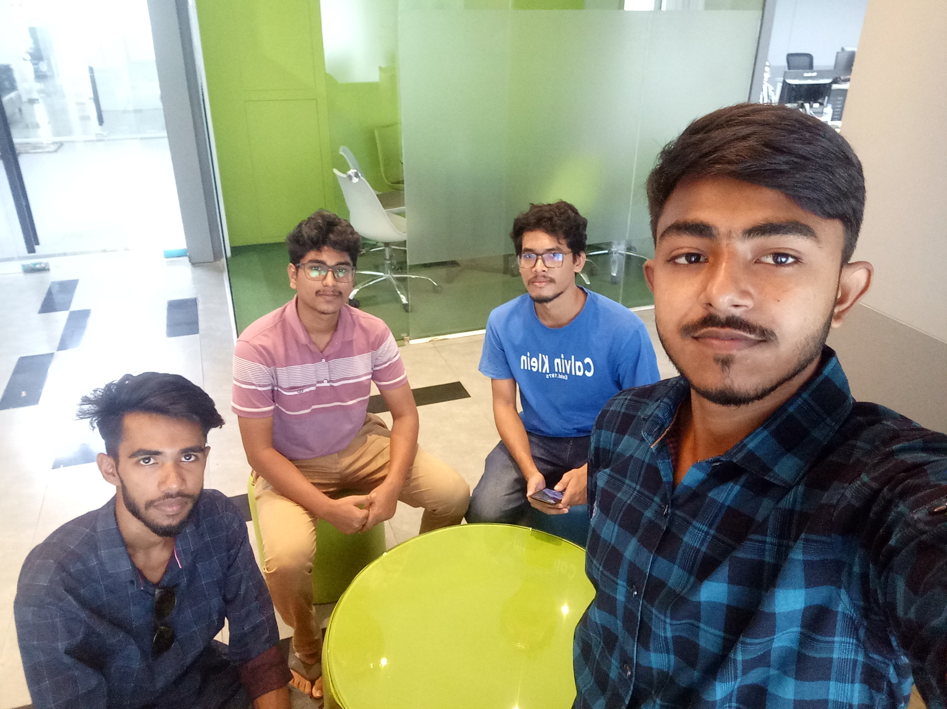
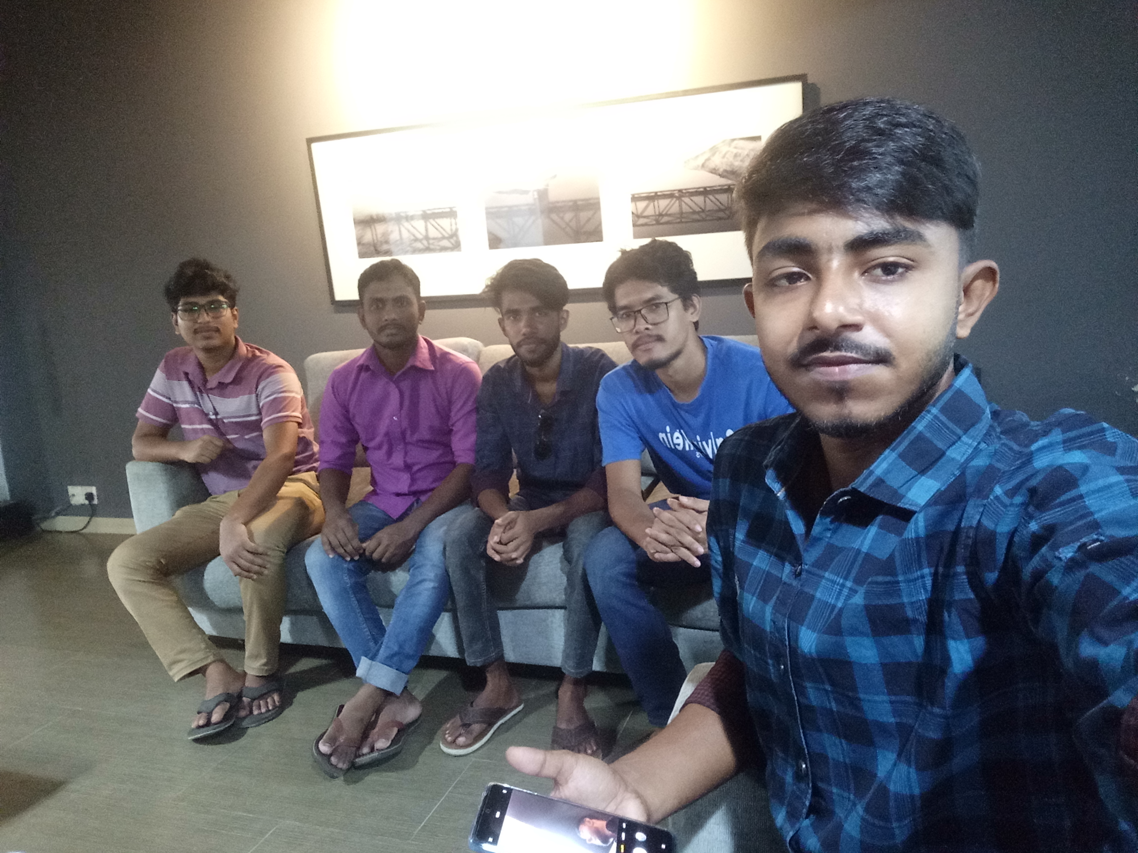
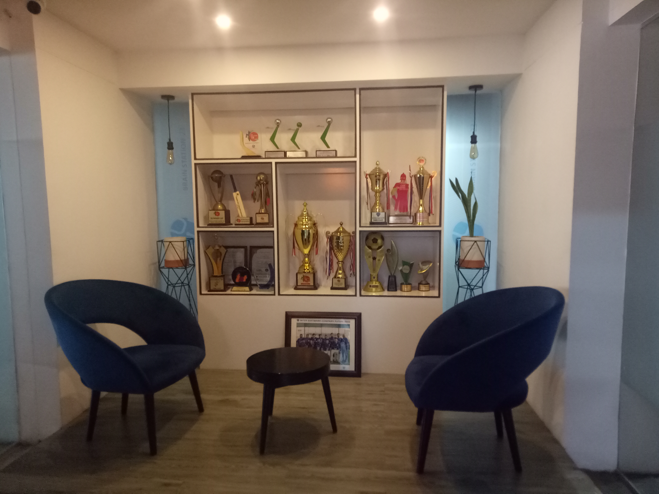
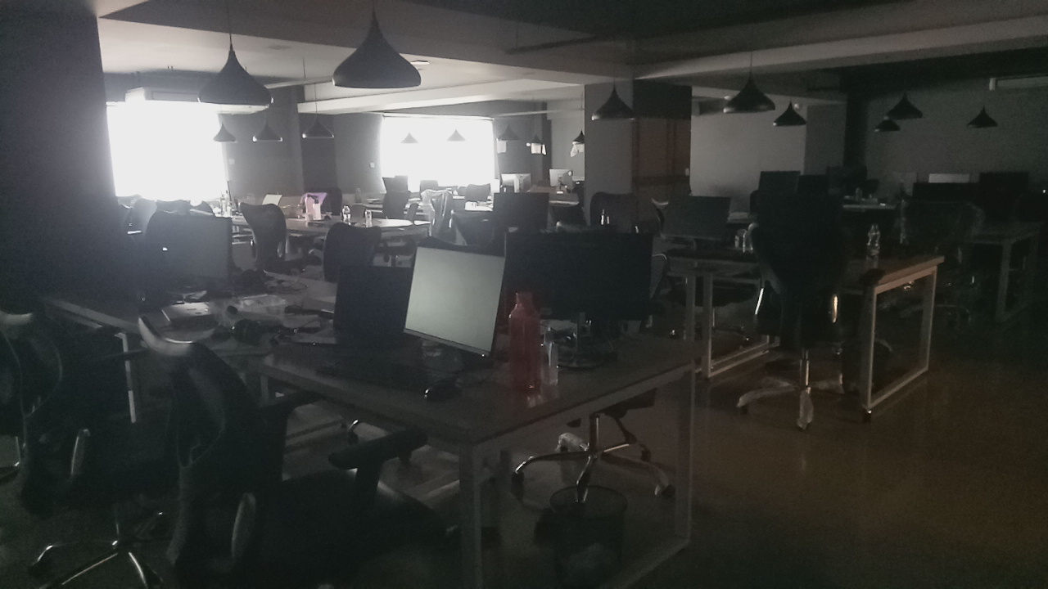
Day 03 (Visiting Day)
Computer Science and Engineering

Slide 10
Day 04
Meeting process of client
Splint of project
Payment System
Work delivery system
SQA Engineer work
Testing and fetch
Alpha testing(White box testing)
Bita testing
Gama testing
Black box testing
Quality of code and review
Security of project
Develop company
Others company
Computer Science and Engineering

Slide 11
Day 04
How to work github
Code editing
Code adding
Code marge
Code maintaining
Git server
Git branch
Employee Circular
Importance of educational course
OOP
Data structure
Algorithm
Database
Computer Science and Engineering

Slide 12
Day 05
Real time of project
Parallel team work
Responsibility of an employee
Discuss about office off day
Ability of an employee
Computer Science and Engineering

Slide 13
Day 06
Type of Software company
Self product company
Delivery product company
Official work system
Discuss about jira
Discuss about trello
Discuss about teams
Computer Science and Engineering

Slide 14
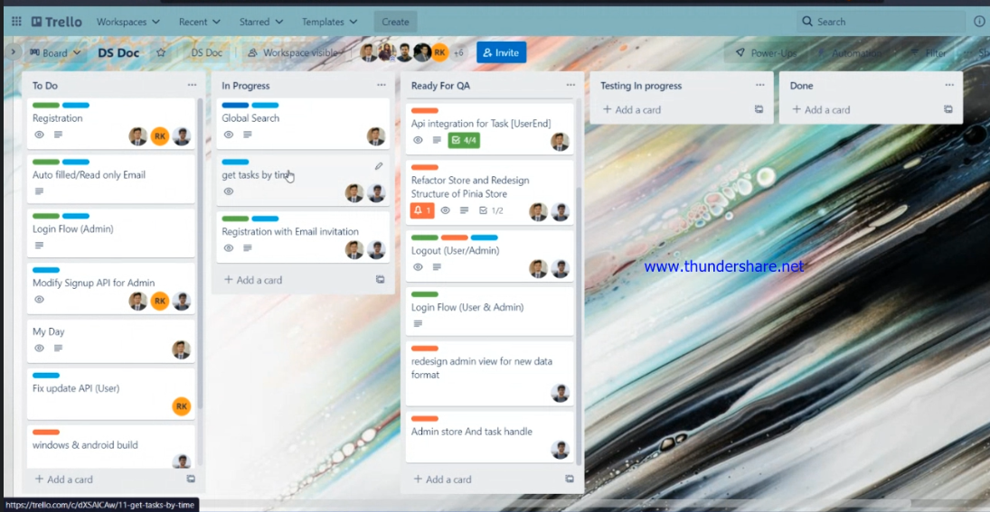
Day 06
Trello
Computer Science and Engineering

Slide 15
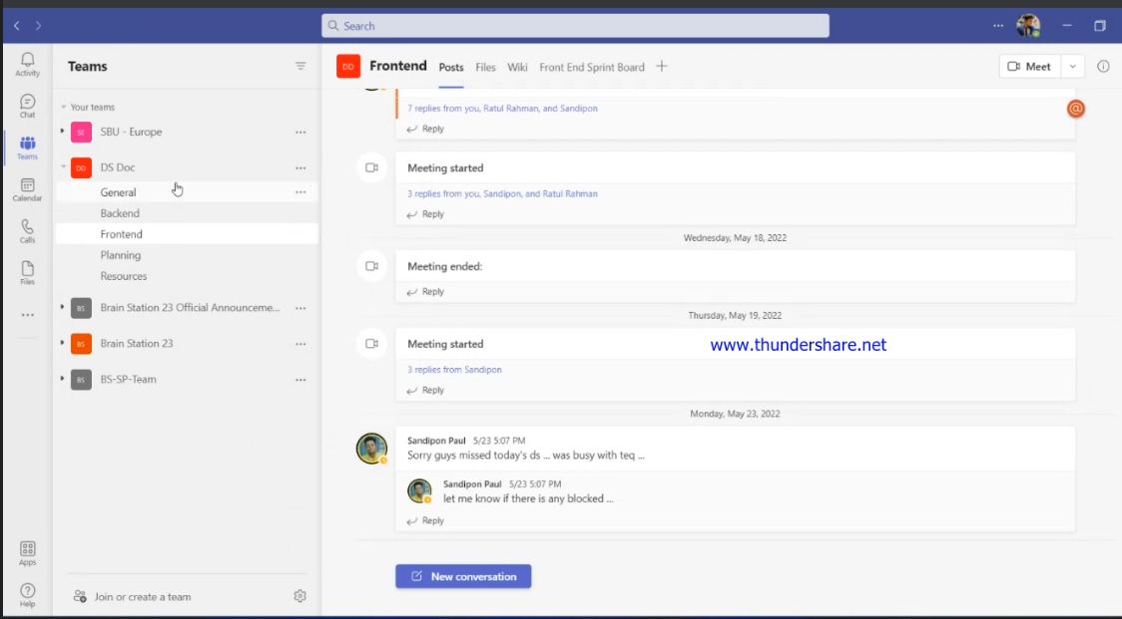
Day 06
Teams
Computer Science and Engineering

Slide 16
Reference
Five days online training class video link:
https://drive.google.com/drive/folders/1v7xksL6wrqXHZYPOSwJfNZe1kLc-VGoQ?usp=sharing
And also provide the previous year class video link:
https://drive.google.com/drive/folders/1kK2i_XEucpJutXbaHPHN0MwuDV4xnQBC?fbclid=IwAR3ggNMcJW5-RXpmmAcz-ihfgkl44nYi1Qy0WOK4ZRxP5kTtky3b7Hb0rxQ
Computer Science and Engineering

Slide 17
Thanks All
Computer Science and Engineering

